Slide 1
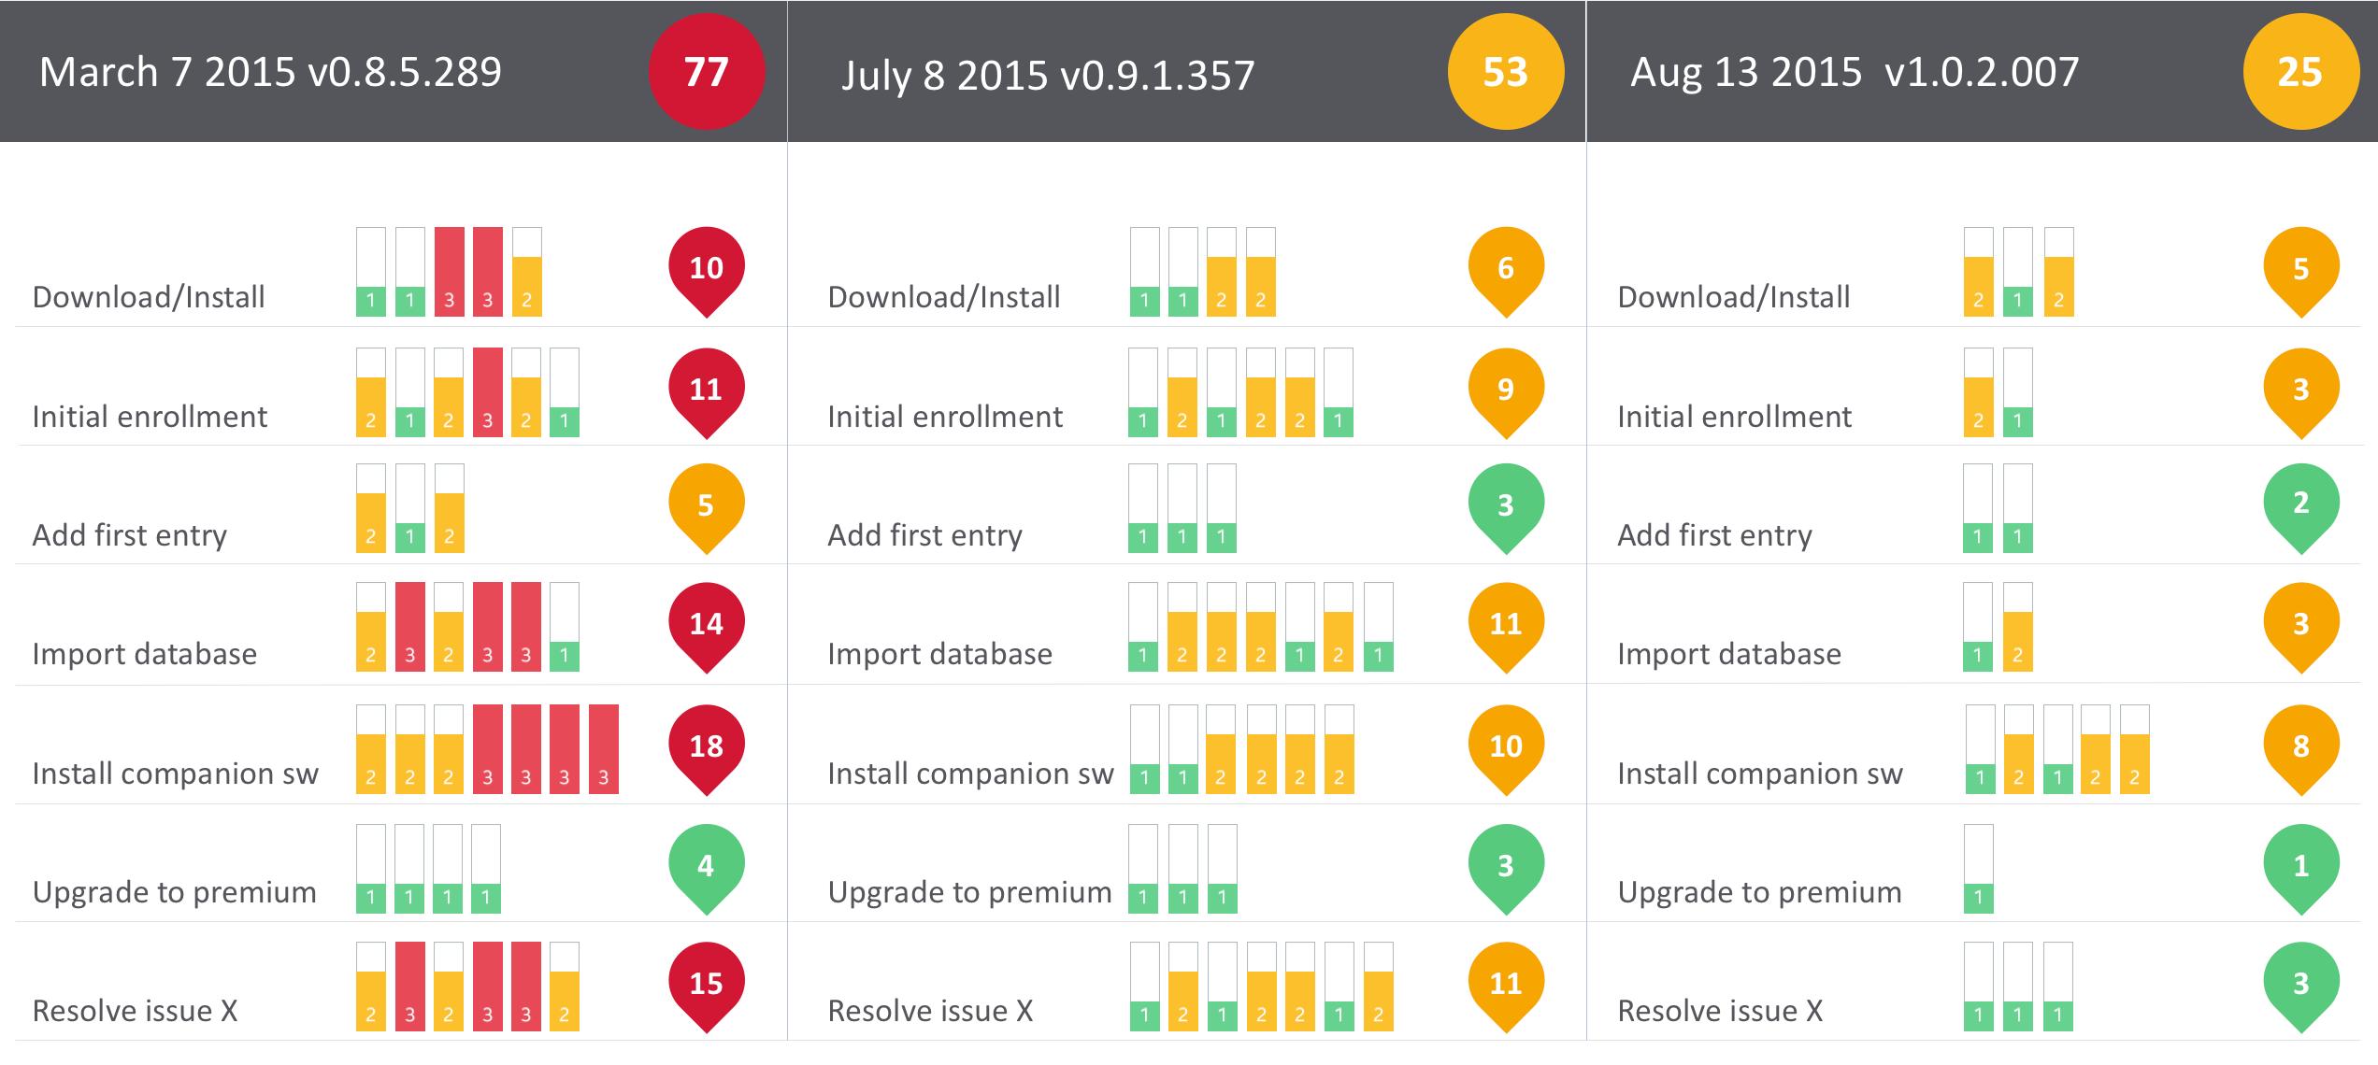
A real Intel product’s PURE Scorecard at Alpha, Beta and Release:
Notes:
#examquestion31

Slide 2
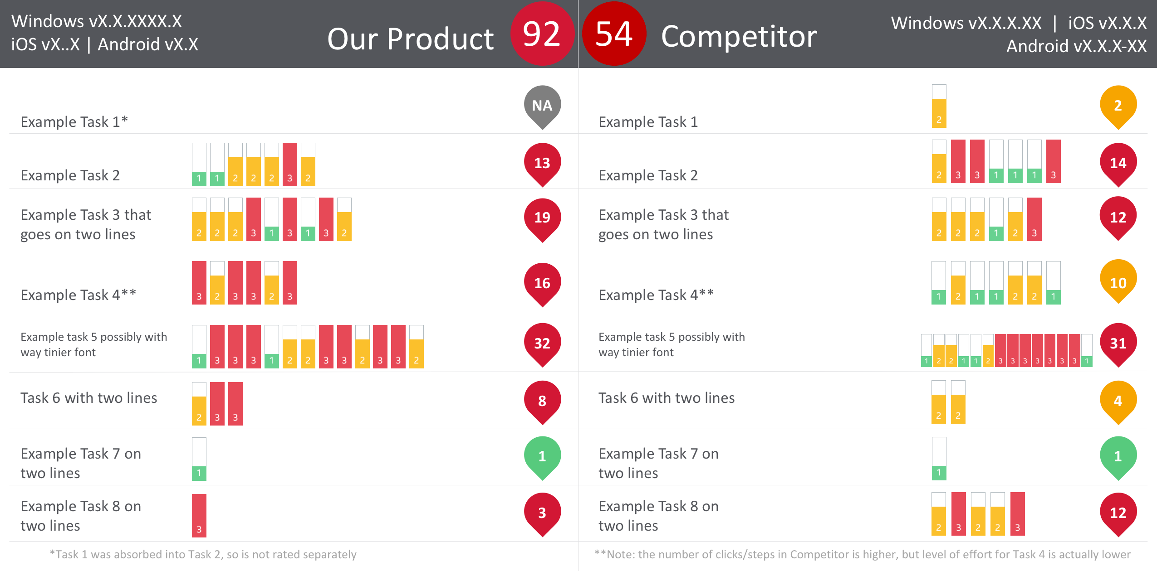
PURE Scorecards for a real consumer security product and its closest competitor
Notes:
#examquestion31

